Slide 1
Module 1 - Algorithm Analysis

Slide 2


Introduction
What is Analysis of an Algorithm?
Analyzing an algorithm means calculating/predicting the resources that the algorithm requires.
Analysis provides theoretical estimation for the required resources of an algorithm to solve a specific computational problem.
Two most important resources are computing time (time complexity) and storage space (space complexity).
Why Analysis is required?
By analyzing some of the candidate algorithms for a problem, the most efficient one can be easily identified.

Slide 3
Efficiency of Algorithm
The efficiency of an algorithm is a measure of the amount of resources consumed in solving a problem of size 𝑛.
An algorithm must be analyzed to determine its resource usage.
Two major computational resources are execution time and memory space.
Memory Space requirement can not be compared directly, so the important resource is computational time required by an algorithm.
To measure the efficiency of an algorithm requires to measure its execution time using any of the following approaches:
Empirical Approach: To run it and measure how much processor time is needed.
Theoretical Approach: Mathematically computing how much time is needed as a function of input size.

Slide 4

How Analysis is Done?
Empirical (posteriori) approach
Theoretical (priori) approach
Programming different competing techniques & running them on various inputs using computer.
Implementation of different techniques may be difficult.
The same hardware and software environments must be used for comparing two algorithms.
Results may not be indicative of the running time on other inputs not included in the experiment.
Determining mathematically the resources needed by each algorithm.
Uses the algorithm instead of an implementation.
The speed of an algorithm can be determined independent of the hardware/software environment.
Characterizes running time as a function of the input size $n,$ considers all possible values.

Slide 5
Time Complexity
Time complexity of an algorithm quantifies the amount of time taken by an algorithm to run as a function of the length of the input.
Running time of an algorithm depends upon,
Input Size
Nature of Input
Generally time grows with the size of input, for example, sorting 100 numbers will take less time than sorting of 10,000 numbers.
So, running time of an algorithm is usually measured as a function of input size.
Instead of measuring actual time required in executing each statement in the code, we consider how many times each statement is executed.
So, in theoretical computation of time complexity, running time is measured in terms of number of steps/primitive operations performed.

Slide 6
Asymptotic Notations
The theoretical (priori) approach of analyzing an algorithm to measure the efficiency does not depend on the implementation of the algorithm.
In this approach, the running time of an algorithm is describes as Asymptotic Notations.
Computing the running time of algorithm’s operations in mathematical units of computation and defining the mathematical formula of its run-time performance is referred to as Asymptotic Analysis.
An algorithm may not have the same performance for different types of inputs. With the increase in the input size, the performance will change.
Asymptotic analysis accomplishes the study of change in performance of the algorithm with the change in the order of the input size.
Using Asymptotic analysis, we can very well define the best case, average case, and worst case scenario of an algorithm.

Slide 7
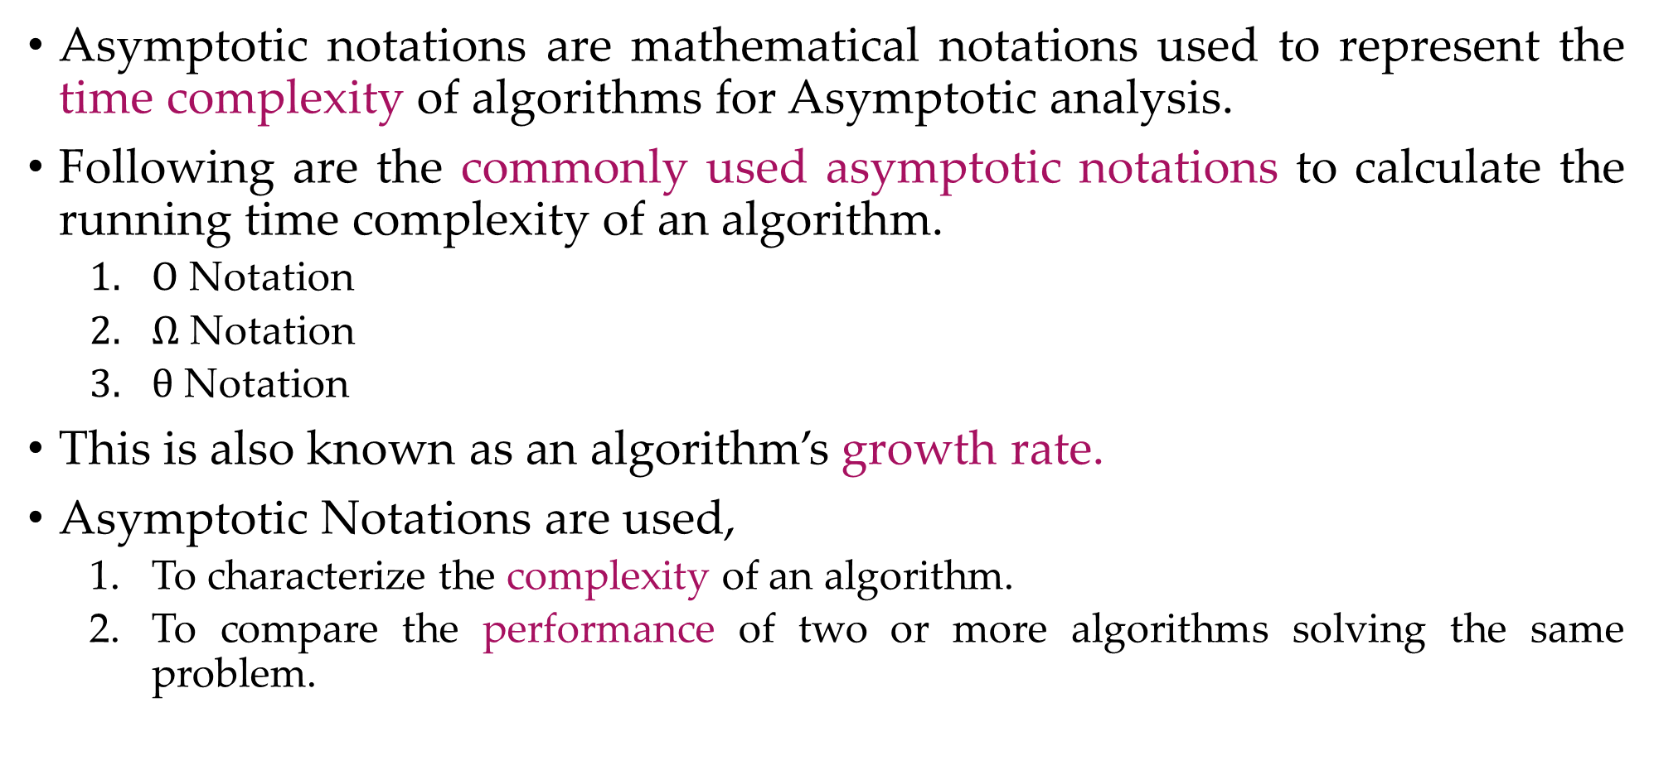
Asymptotic Notations
Asymptotic notations are mathematical notations used to represent the time complexity of algorithms for Asymptotic analysis.
Following are the commonly used asymptotic notations to calculate the running time complexity of an algorithm.
$Ο$ Notation
$Ω$ Notation
$θ$ Notation
This is also known as an algorithm’s growth rate.
Asymptotic Notations are used,
To characterize the complexity of an algorithm.
To compare the performance of two or more algorithms solving the same problem.

Slide 8
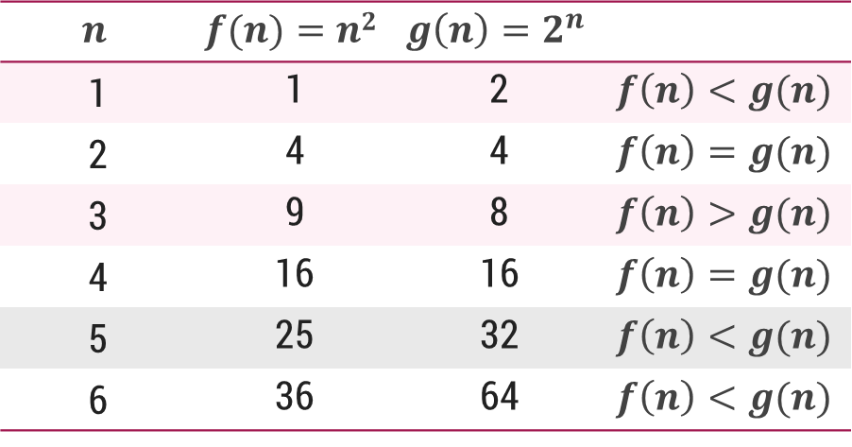

$O$-Notation (Big $O$ notation) (Upper Bound)
The notation $Ο(n)$ is the formal way to express the upper bound of an algorithm's running time.
It measures the worst case time complexity or the longest amount of time an algorithm can possibly take to complete.
For a given function $g(n)$, we denote by $Ο(g(n))$the set of functions,
$Ο(g(n))$= {$f(n)$ : there exist positive constants $c$ and $n0$ such that $0≤f(n)≤cg(n)$for all $n0≤n$}

Slide 9
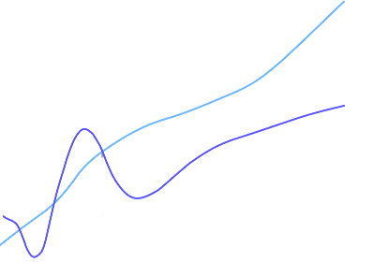

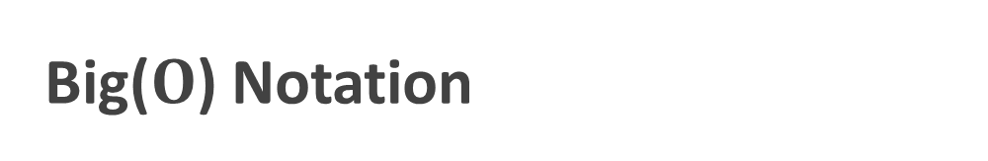

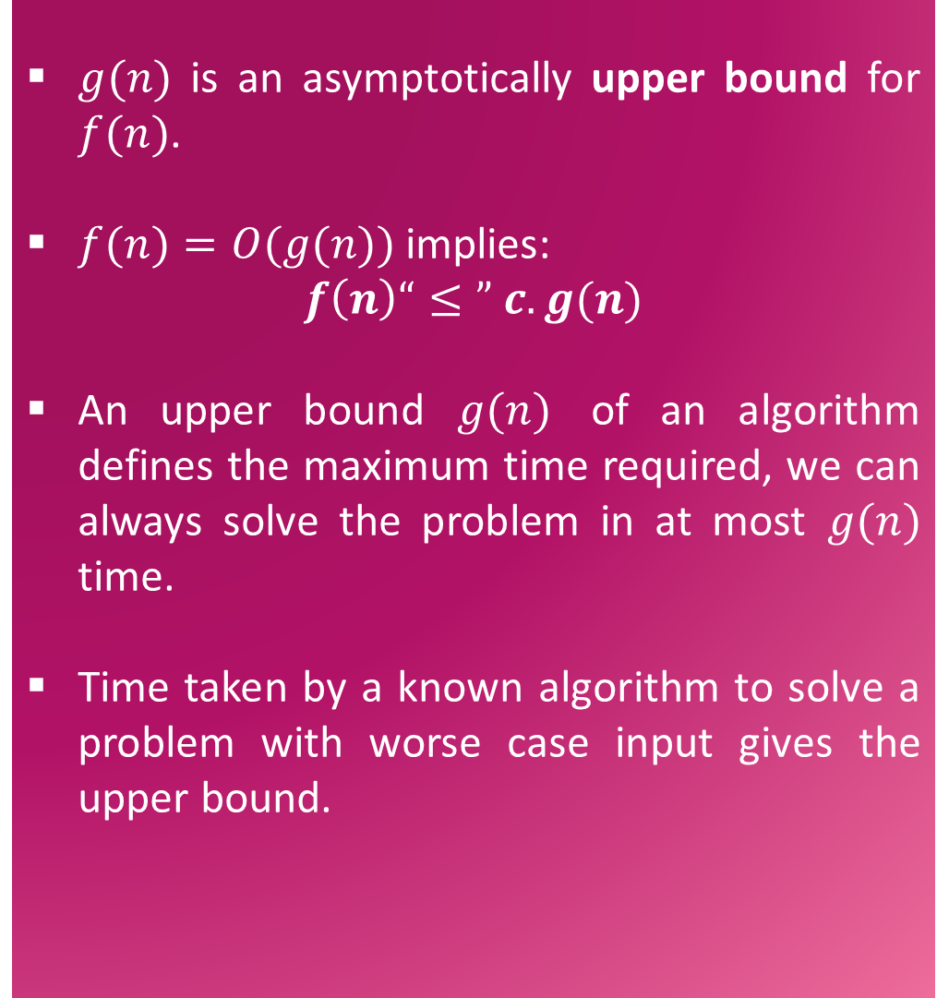



Big($O$) Notation
$g(n)$ is an asymptotically upper bound for $f(n)$.
$f(n)=O(g(n))$implies:
$$f\left(n\right)“≤” c.g(n)$$
An upper bound $g(n)$ of an algorithm defines the maximum time required, we can always solve the problem in at most $g(n)$ time.
Time taken by a known algorithm to solve a problem with worse case input gives the upper bound.
$$c.g(n)$$
$$f(n)$$
$$n$$
$$n_{0}$$
$$f(n)=O(g(n))$$

Slide 10
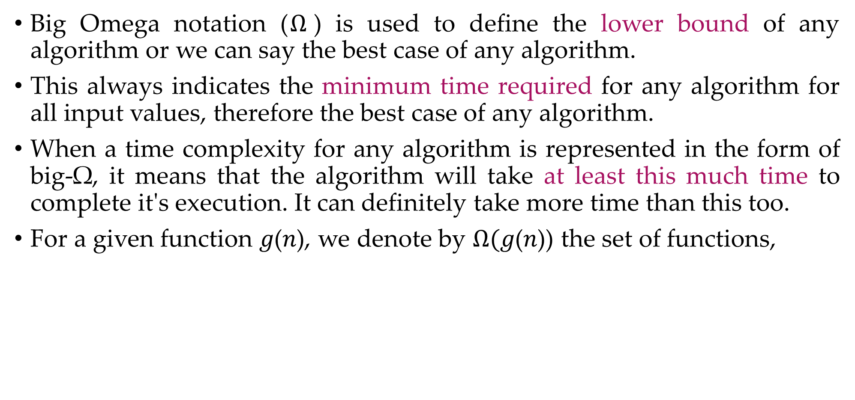
$Ω$-Notation (Omega notation) (Lower Bound)
Big Omega notation ($Ω$) is used to define the lower bound of any algorithm or we can say the best case of any algorithm.
This always indicates the minimum time required for any algorithm for all input values, therefore the best case of any algorithm.
When a time complexity for any algorithm is represented in the form of big-Ω, it means that the algorithm will take at least this much time to complete it's execution. It can definitely take more time than this too.
For a given function 𝑔(𝑛), we denote by $Ω($𝑔(𝑛)) the set of functions,
$Ω(g(n))=\{f(n):$there exist positive constants $c$ and $n_{0}$ such that $0≤cg\left(n\right)≤f\left(n\right)$for all $n_{0}≤n\}$

Slide 11
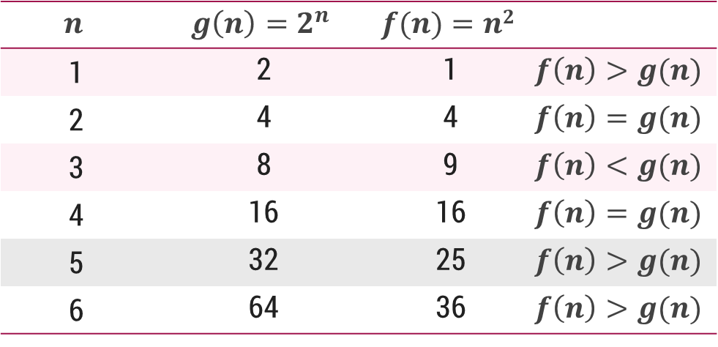

$Ω$-Notation (Omega notation) (Lower Bound)
For a given function 𝑔(𝑛), we denote by $Ω($𝑔(𝑛)) the set of functions,
$Ω(g(n))=\{f(n):$there exist positive constants $c$ and $n_{0}$ such that $0≤cg\left(n\right)≤f\left(n\right)$for all $n_{0}≤n\}$

Slide 12
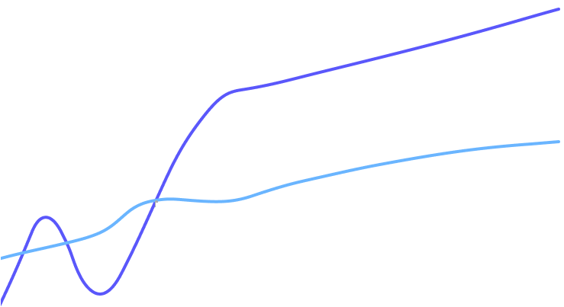

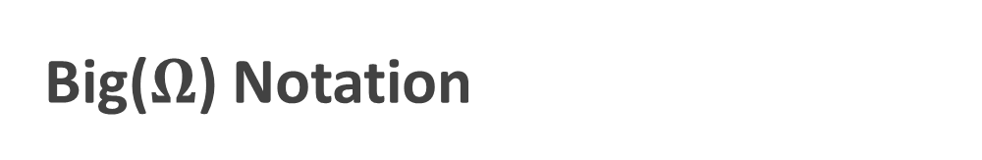
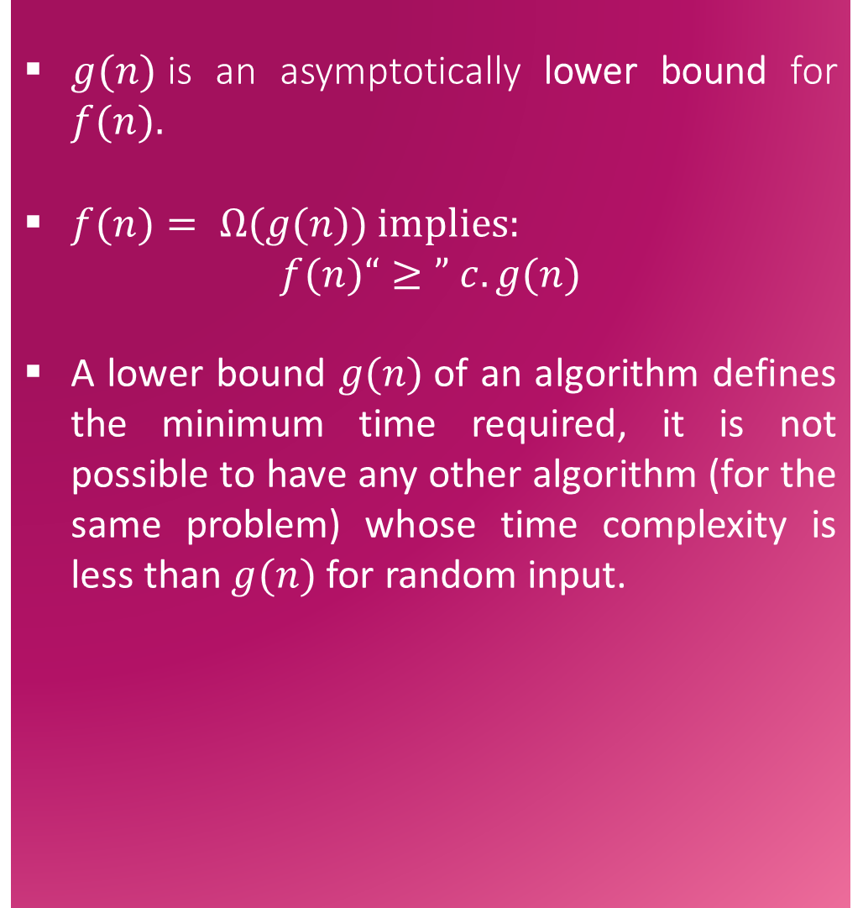


Big($Ω$) Notation
$g(n)$is an asymptotically lower bound for $f(n).$
$f(n)= Ω(g(n))$implies:
$$f(n)“≥” c.g(n)$$
A lower bound $g(n)$of an algorithm defines the minimum time required, it is not possible to have any other algorithm (for the same problem) whose time complexity is less than $g(n)$ for random input.
$$f(n)$$
$$c.g(n)$$
$$n$$
$$n_{0}$$
$$f(n)=Ω(g(n))$$

Slide 13
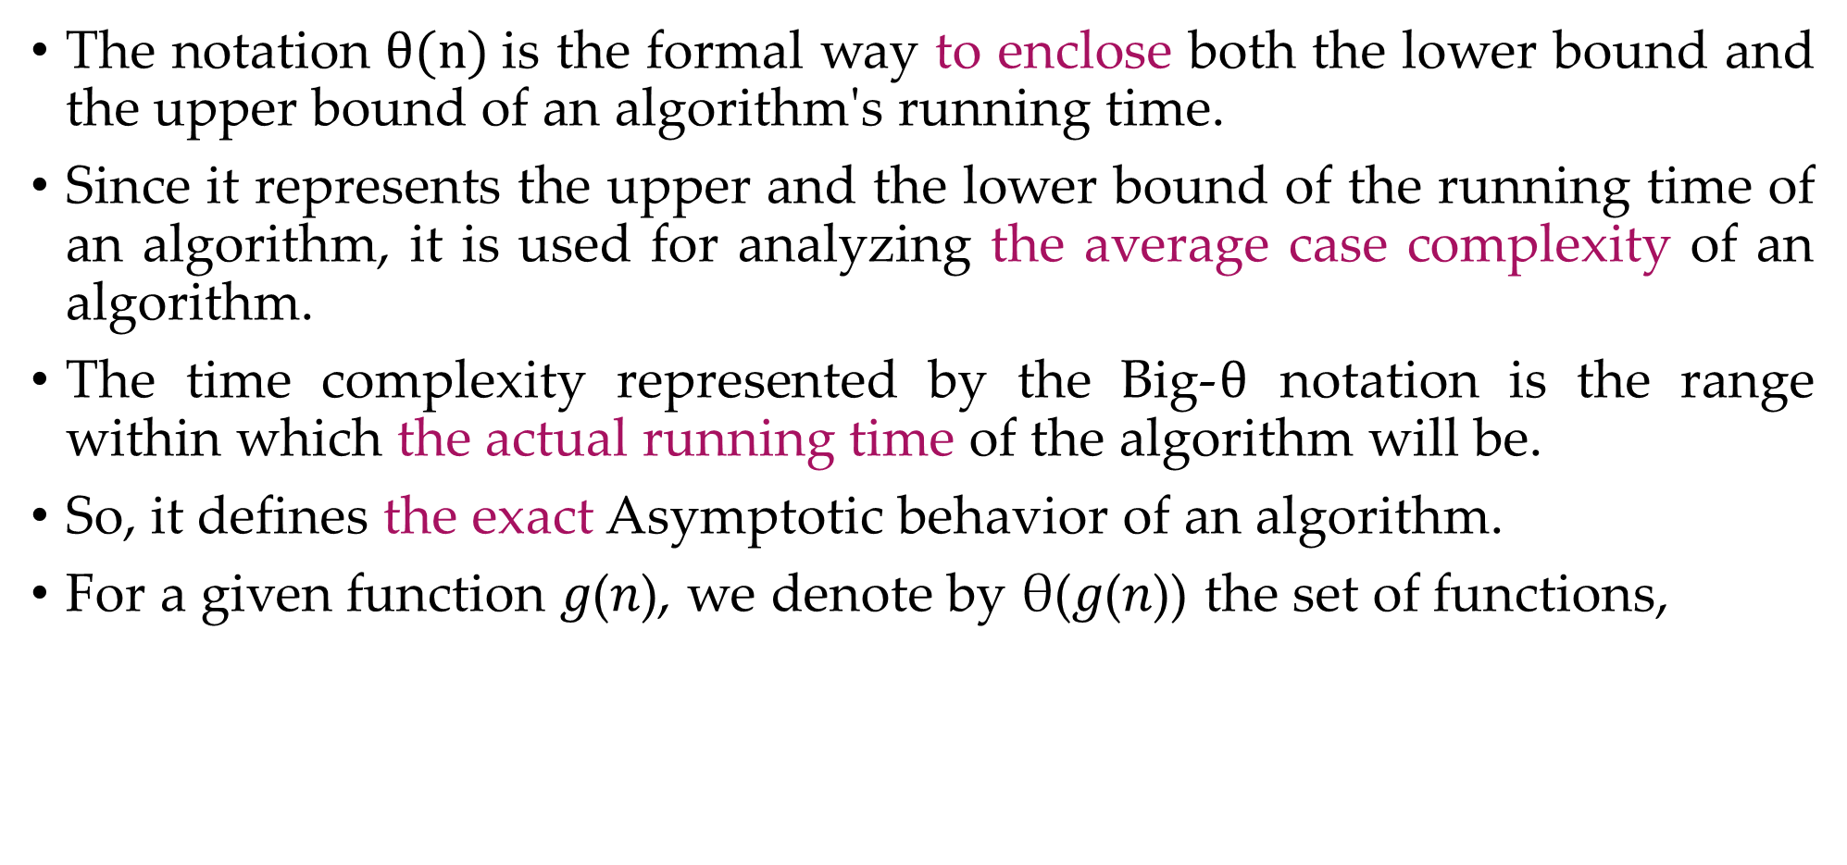
$θ$-Notation (Theta notation) (Same order)
The notation $θ(n)$is the formal way to enclose both the lower bound and the upper bound of an algorithm's running time.
Since it represents the upper and the lower bound of the running time of an algorithm, it is used for analyzing the average case complexity of an algorithm.
The time complexity represented by the Big-$θ$ notation is the range within which the actual running time of the algorithm will be.
So, it defines the exact Asymptotic behavior of an algorithm.
For a given function 𝑔(𝑛), we denote by θ(𝑔(𝑛)) the set of functions,
$θ(g(n)) = \{f(n) :$there exist positive constants $c_{1}, c_{2} and n0 such that 0≤c_{1}g\left(n\right)≤f\left(n\right)≤c_{2}g\left(n\right) for all n0≤n\}$

Slide 14
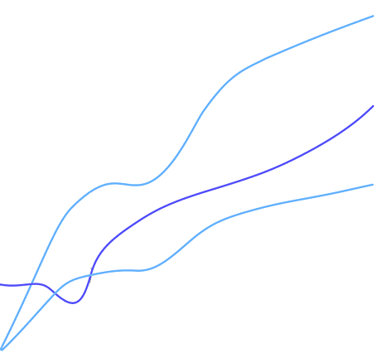

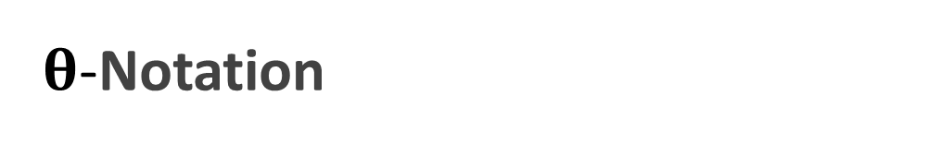
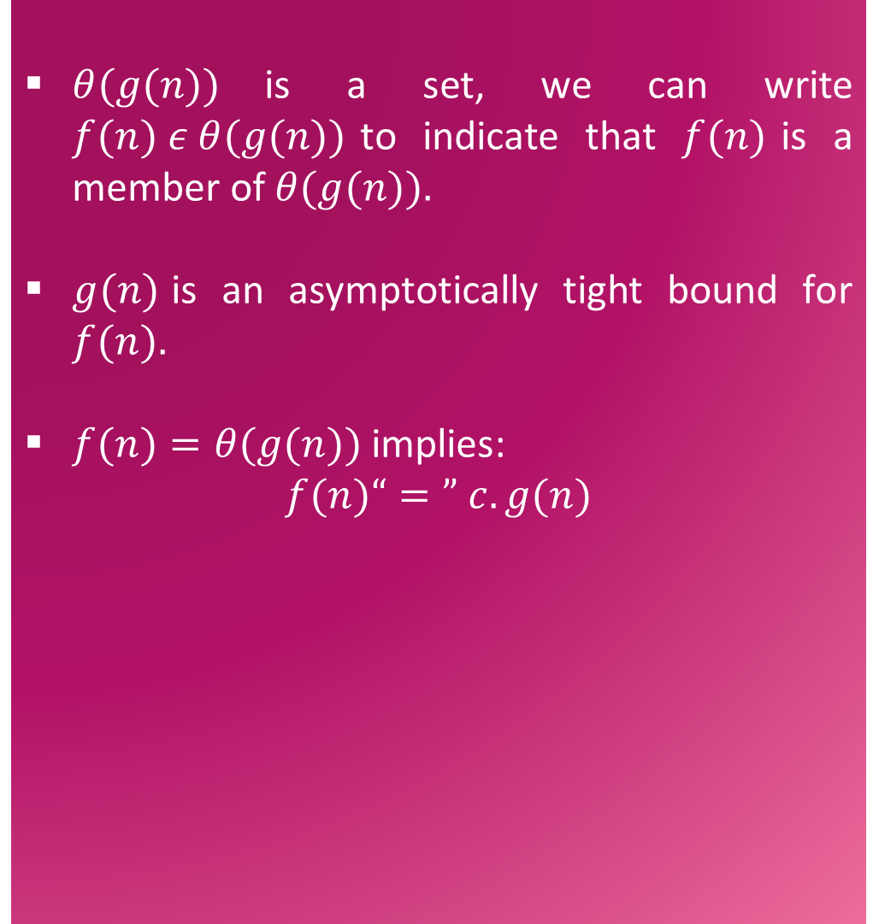





$θ$-Notation
$θ(g(n))$is a set, we can write $f(n) ε θ(g(n))$to indicate that $f(n)$is a member of $θ(g(n)).$
$g(n)$is an asymptotically tight bound for $f(n).$
$f(n)=θ(g(n))$implies:
$$f(n)“=” c.g(n)$$
$$c_{2}.g(n)$$
$$f(n)$$
$$c_{1}.g(n)$$
$$n$$
$$n_{0}$$
$$f(n)=θ(g(n))$$

Slide 15
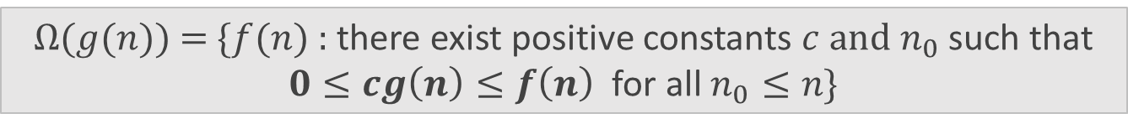

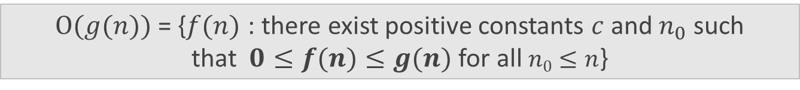


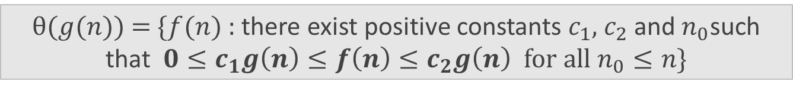
Asymptotic Notations
O-Notation (Big O notation) (Upper Bound)
Ω-Notation (Omega notation) (Lower Bound)
θ-Notation (Theta notation) (Same order)
$Ο(g(n))$= {$f(n)$ : there exist positive constants $c$ and${ n}_{0}$ such that$0≤f(n)≤g(n)$for all$n0≤n$}
$$f(n)=O(g(n))$$
$Ω(g(n))$= {$f(n)$ : there exist positive constants $c$ and $n_{0}$ such that $0≤cg\left(n\right)≤f\left(n\right)$ for all $n_{0}≤n$}
$$f\left(n\right)=Ω(g(n))$$
$θ(g(n))$ = {$f(n)$ : there exist positive constants $c_{1}$, $c_{2}$ and${ n}_{0}$such that $0≤c_{1}g\left(n\right)≤f\left(n\right)≤c_{2}g\left(n\right)$ for all $n_{0}≤n$}
$$f(n)=θ(g(n))$$

Slide 16

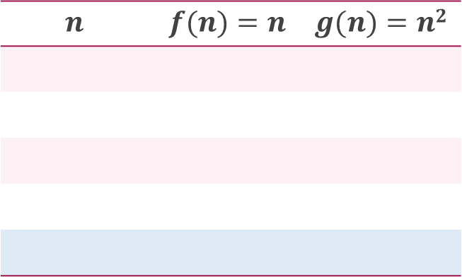


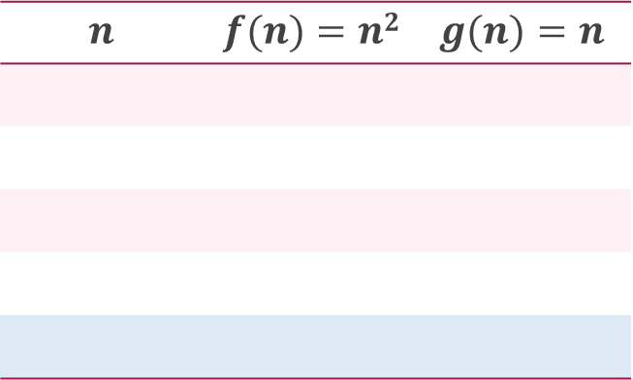

Asymptotic Notations – Examples
Example 1:
$f(n)=n^{2}$ and $g\left(n\right)=n$
Example 2:
$f\left(n\right)=n$ and $g\left(n\right)=n^{2}$
Algo. 1 running time
Algo. 2 running time
Algo. 1 running time
Algo. 2 running time
$$f\left(n\right)≥g\left(n\right)⟹f\left(n\right)=Ω(g(n))$$
$$f\left(n\right)≤g\left(n\right)⟹f\left(n\right)=O(g(n))$$
$$n$$ | $$f(n)=n2$$ | $$g(n)=n$$
$$n$$ | $$f(n)=n$$ | $$g(n)=n2$$
1
1
1
1
1
1
2
4
2
2
2
4
3
9
3
3
3
9
4
16
4
4
4
16
5
25
5
5
5
25

Slide 17



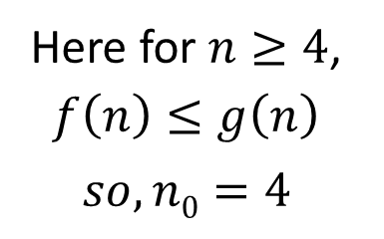
Asymptotic Notations – Examples
Example 3: $f\left(n\right)=n^{2}$ and $g\left(n\right)= 2^{n}$
$$f\left(n\right)≤g\left(n\right)⟹f\left(n\right)=O(g(n))$$
$$n$$ | $$f(n)=n2$$ | $$g(n)=2n$$
1 |  |  | $$f(n) < g(n)$$
2 |  |  | $$f(n) = g(n)$$
3 |  |  | $$f(n) > g(n)$$
4 |  |  | $$f(n) = g(n)$$
5 |  |  | $$f(n) < g(n)$$
6 |  |  | $$f(n) < g(n)$$
7 |  |  | $$f(n) < g(n)$$
1
2
4
4
9
8
16
16
Here for $n≥4$, $f\left(n\right)≤g\left(n\right)$
$$so, n0=4$$
25
32
36
64
49
128

Slide 19
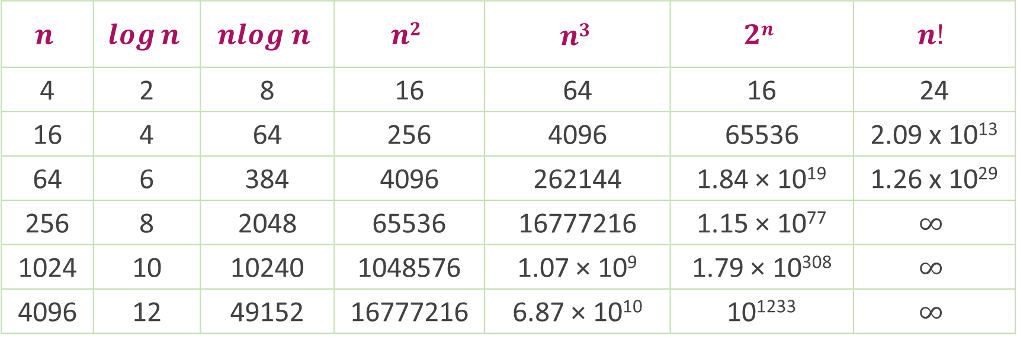
Common Orders of Magnitude
$$n$$ | $$\log{n}$$ | $$nlog n$$ | $$n2$$ | $$n3$$ | $$2n$$ | $$n!$$
4 | 2 | 8 | 16 | 64 | 16 | 24
16 | 4 | 64 | 256 | 4096 | 65536 | 2.09 x 10¹³
64 | 6 | 384 | 4096 | 262144 | 1.84 × 10¹⁹ | 1.26 x 10²⁹
256 | 8 | 2048 | 65536 | 16777216 | 1.15 × 10⁷⁷ | $$∞$$
1024 | 10 | 10240 | 1048576 | 1.07 × 10⁹ | 1.79 × 10³⁰⁸ | $$∞$$
4096 | 12 | 49152 | 16777216 | 6.87 × 10¹⁰ | 10¹²³³ | $$∞$$

Slide 20

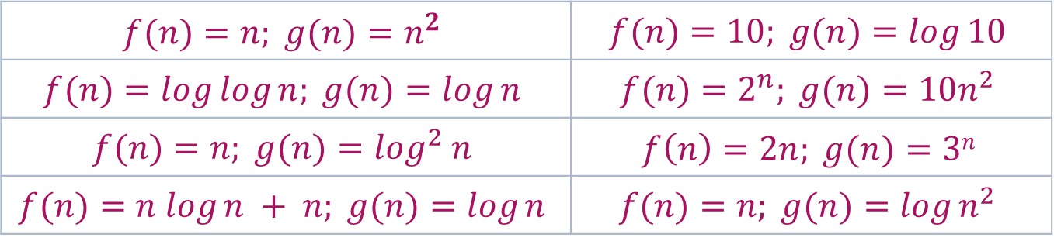
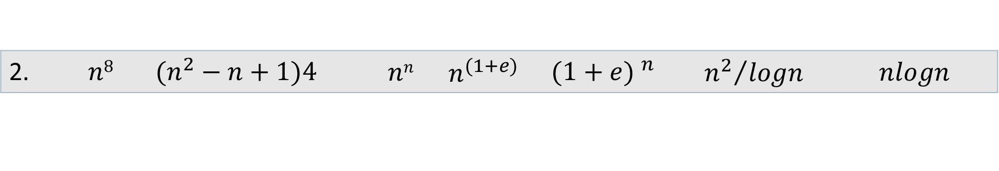
Growth of Function
$$n!$$ | $$en$$ | $$2n$$ | $$n3$$ | $$n2$$ | $$nlogn$$ | $$n$$ | $$\sqrt{n}$$ | $$logn$$ | $$1$$
Arrange the given notations in the increasing order of their values.
For each of the following pairs of functions, either $f(n)$ is $O(g(n))$, $f(n)$ is $Ω(g(n))$, or $f(n) =θ(g(n))$. Determine which relationship is correct.
1. | $$n$$ | $$nlogn$$ | $$2n$$ | $$logn$$ | $$\sqrt{n}$$ | $$en$$ | $$n2+logn$$ | $$n2$$ | $$loglogn$$ | $$n3$$ | $$(logn)2$$ | $$n!$$
2. | $$n8$$ | $$(n^{2}−n+1)4{}^{}$$ | $$nn$$ | $$n^{(1+e)}$$ | $${(1+e) }^{n}$$ | $${n^{2}}/{logn}$$ | $$nlogn$$
$$f(n)=n; g(n)=n^{2}$$ | $$f(n)=10; g(n)=log⁡10$$
$$f(n)=log⁡log⁡n; g(n)=log⁡n$$ | $$f(n)=2^{n}; g(n)=10n^{2}$$
$$f(n)=n; g(n)=\log^{2} n$$ | $$f\left(n\right)=2n; g(n)=3n$$
$$f(n)=n log⁡n + n; g(n)=log⁡n$$ | $$f(n)=n; g(n)=log⁡n^{2}$$

Slide 21
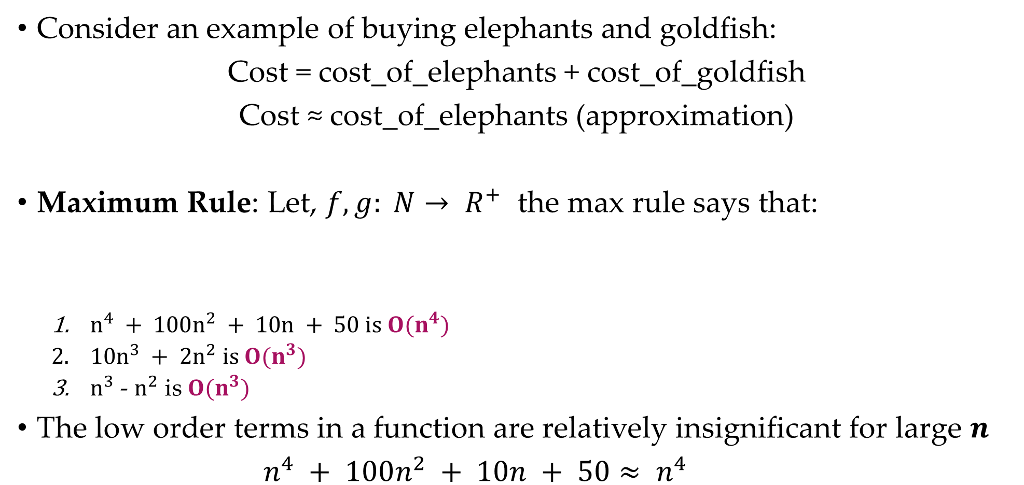
Asymptotic Notations in Equations
Consider an example of buying elephants and goldfish:
Cost = cost_of_elephants + cost_of_goldfish
Cost ≈ cost_of_elephants (approximation)
Maximum Rule: Let, $f, g: N→ R^{+}$ the max rule says that:
$n^{4} + 100n^{2} + 10n + 50 is O(n^{4})$
$10n^{3} + 2n^{2} is O(n^{3})$
$n^{3}$ - $n^{2}$ is $O(n^{3})$
The low order terms in a function are relatively insignificant for large 𝒏
$n^{4} + 100n^{2} + 10n + 50≈ n^{4}$
Negligible
𝑂( 𝑓(𝑛)+𝑔(𝑛))=𝑂(max⁡(𝑓(𝑛),𝑔(𝑛)))

Slide 22

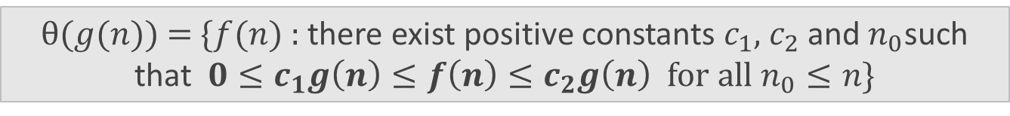
Asymptotic Notations
O-Notation (Big O notation) (Upper Bound)
Ω-Notation (Omega notation) (Lower Bound)
θ-Notation (Theta notation) (Same order)
$Ο(g(n))$= {$f(n)$ : there exist positive constants $c$ and${ n}_{0}$ such that$0≤f(n)≤g(n)$for all$n0≤n$}
$$f(n)=O(g(n))$$
$Ω(g(n))$= {$f(n)$ : there exist positive constants $c$ and $n_{0}$ such that $0≤cg\left(n\right)≤f\left(n\right)$ for all $n_{0}≤n$}
$$f\left(n\right)=Ω(g(n))$$
$θ(g(n))$ = {$f(n)$ : there exist positive constants $c_{1}$, $c_{2}$ and${ n}_{0}$such that $0≤c_{1}g\left(n\right)≤f\left(n\right)≤c_{2}g\left(n\right)$ for all $n_{0}≤n$}
$$f(n)=θ(g(n))$$

Slide 23

Expressing Function in terms of 𝑂, $Ω$, θ notation
Find Big O notation for $f\left(n\right)=2n+6n2+3n$
$$2n+6n2+3n≤2n+6n2+n2$$
$$2n+7n2≤2n+2n$$
$$f\left(n\right)≤4n$$
$$C=2, g\left(n\right)=2n$$
$$f\left(n\right)=O(2n)$$

Slide 24
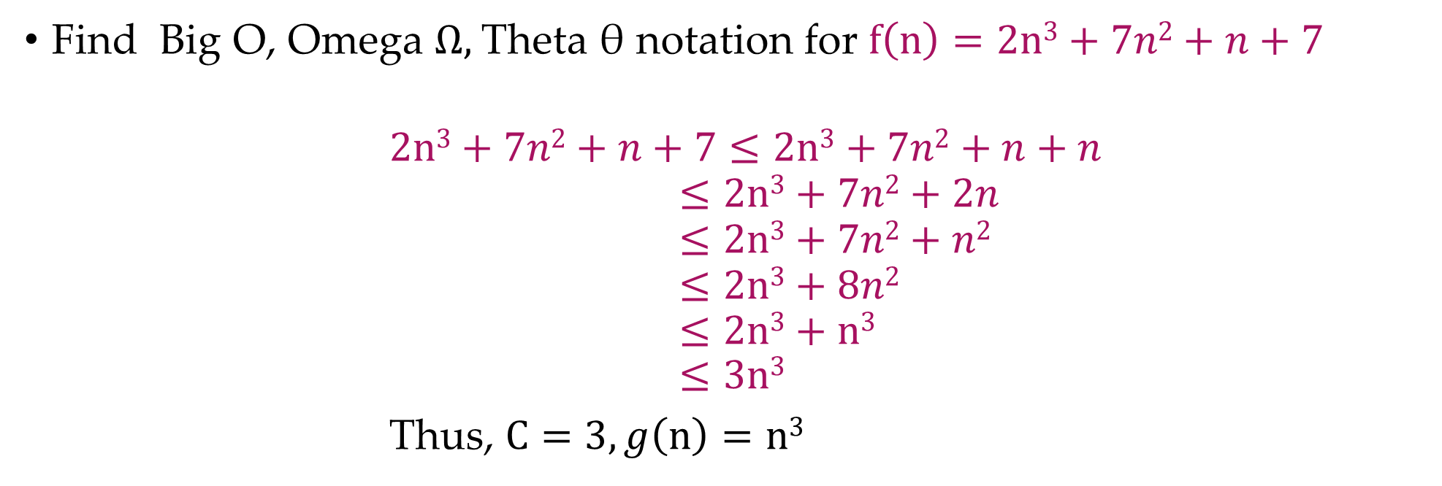
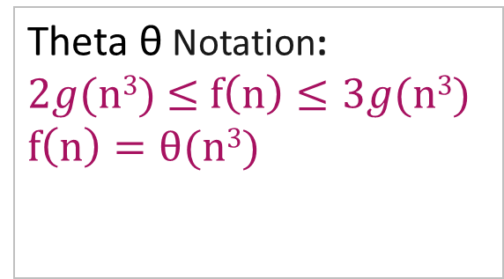
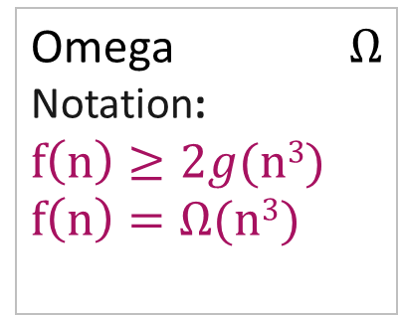
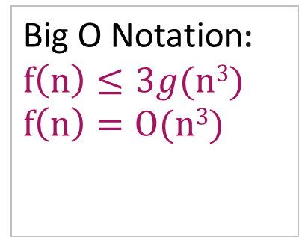
Expressing Function in terms of 𝑂, $Ω$, θ notation
Find Big O, Omega $Ω,$Theta θ notation for $f\left(n\right)=2n3+7n2+n+7$
$$2n3+7n2+n+7≤2n3+7n2+n+n$$
$$≤2n3+7n2+2n$$
$$≤2n3+7n2+n2$$
$$≤2n3+8n2$$
$$≤2n3+n3$$
$$≤3n3$$
Thus, $C=3, g\left(n\right)=n3$
Big O Notation:
$$f\left(n\right)≤3g(n3)$$
$$f\left(n\right)=O(n3)$$
Omega $Ω$ Notation:
$$f\left(n\right)≥2g(n3)$$
$$f\left(n\right)=Ω(n3)$$
Theta θ Notation:
$2g(n3)$ $≤$ $f\left(n\right)≤3g(n3)$
$$f\left(n\right)=θ(n3)$$

Slide 25
Recurrence Equation

Slide 26
Introduction
Many algorithms (divide and conquer) are recursive in nature.
When we analyze them, we get a recurrence relation for time complexity.
We get running time as a function of 𝒏 (input size) and we get the running time on inputs of smaller sizes.
A recurrence is a recursive description of a function, or a description of a function in terms of itself.
A recurrence relation recursively defines a sequence where the next term is a function of the previous terms.

Slide 27
Introduction
Many algorithms (divide and conquer) are recursive in nature.
When we analyze them, we get a recurrence relation for time complexity.
We get running time as a function of 𝒏 (input size) and we get the running time on inputs of smaller sizes.
A recurrence is a recursive description of a function, or a description of a function in terms of itself.
A recurrence relation recursively defines a sequence where the next term is a function of the previous terms.

Slide 28



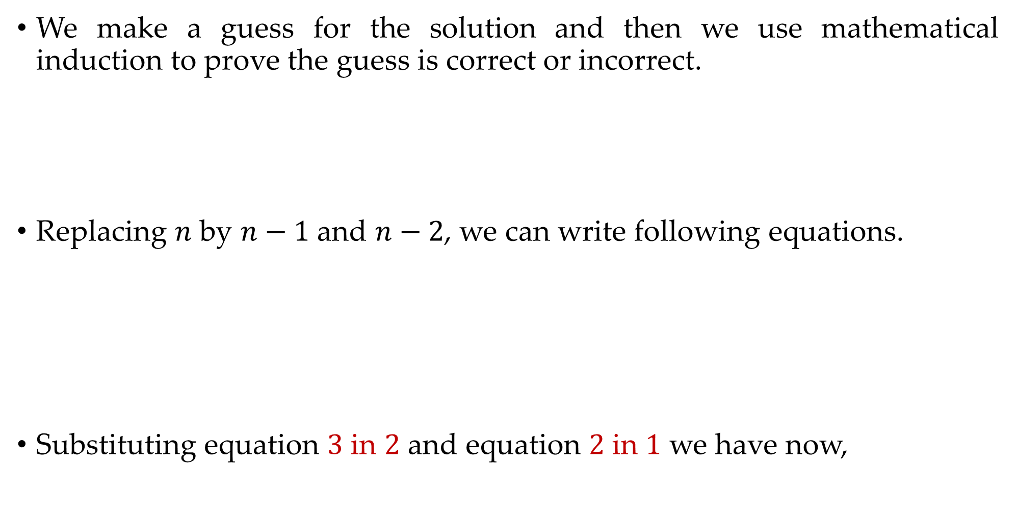


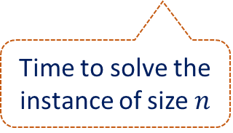
Substitution Method – Example 1
We make a guess for the solution and then we use mathematical induction to prove the guess is correct or incorrect.
Replacing $n$ by $n−1$ and $n−2$, we can write following equations.
Substituting equation $3$ in $2$ and equation $2$ in $1$ we have now,
Time to solve the instance of size $n − 1$
Example 1:
$$T(n)=T(n−1)+n$$
1
Time to solve the instance of size $n$
$$T\left(n−1\right)=T\left(n−2\right)+n−1$$
2
$$T\left(n−2\right)=T\left(n−3\right)+n−2$$
3
$$T(n)=T(n−3)+n−2+n−1+n$$
4

Slide 29

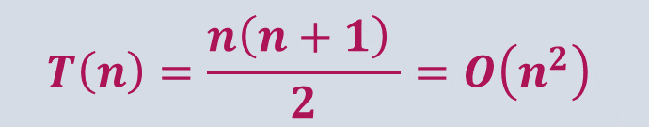


Substitution Method – Example 1
From above, we can write the general form as,
Suppose, if we take $k = n$then,
$$T(n)=T(n−3)+n−2+n−1+n$$
4
$$T\left(n\right)=T\left(n−k\right)+(n−k+1)+(n−k+2)+ …+n$$
$$T\left(n\right)=T\left(n−n\right)+(n−n+1)+(n−n+2)+ …+n$$
$$T\left(n\right)=0+1+2+ …+n$$
$$T\left(n\right)=\frac{n\left(n+1\right) }{2}=O\left(n^{2}\right)$$

Slide 30

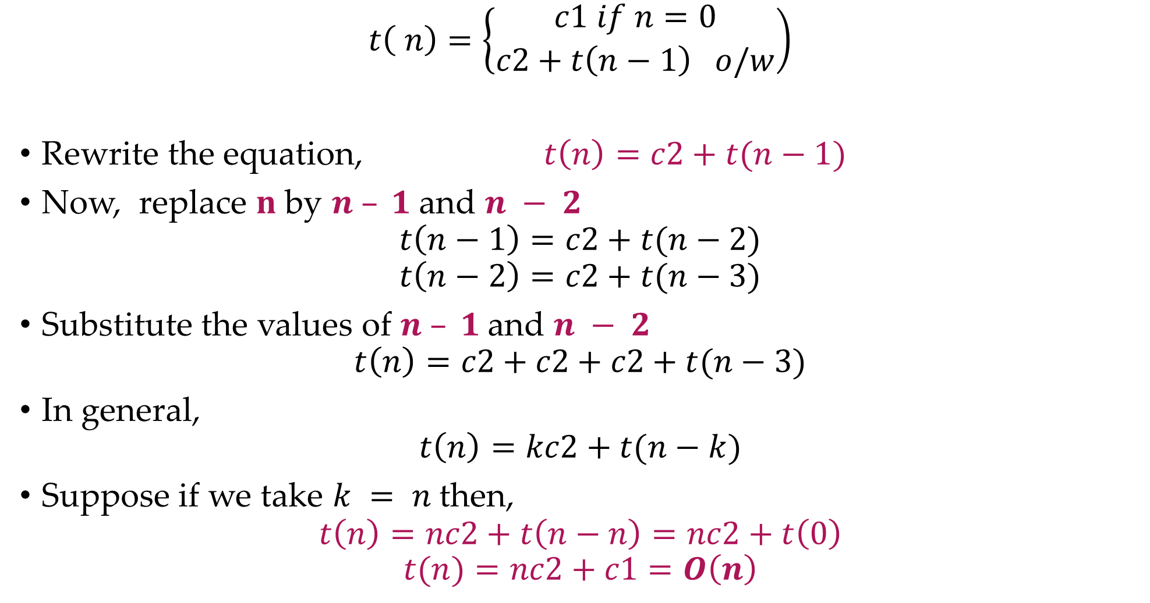
Substitution Method – Example 2
$$t\left( n\right)=\left\{\begin{aligned}c1 if n=0 \\ c2+t\left(n−1\right) o/w\end{aligned}\right)$$
Rewrite the equation, $t\left(n\right)=c2+t(n−1)$
Now, replace $n$ by $n – 1$and $n − 2$
$$t\left(n−1\right)=c2+t(n−2)$$
$$t\left(n−2\right)=c2+t(n−3)$$
Substitute the values of $n – 1$and $n − 2$
$$t\left(n\right)=c2+c2+c2+t(n−3)$$
In general,
$$t\left(n\right)=kc2+t(n−k)$$
Suppose if we take $k = n$then,
$$t\left(n\right)=nc2+t\left(n−n\right)=nc2+t\left(0\right)$$
$$t(n)=nc2+c1=O\left(n\right)$$
$$∴t\left(n−1\right)=c2+c2+t(n−3)$$

Slide 31
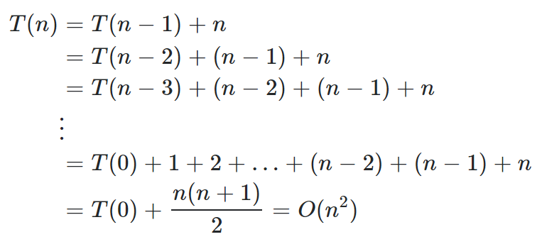

Substitution Method Exercises
Solve the following recurrences using substitution method.
$T\left(n\right)=\left\{\begin{aligned}1 if n=0 or 1 \\ T\left(n−1\right) +n−1 o/w\end{aligned}\right)$
$T (n) = T (n−1) +1$ and $T (1)= θ (1).$

Slide 32
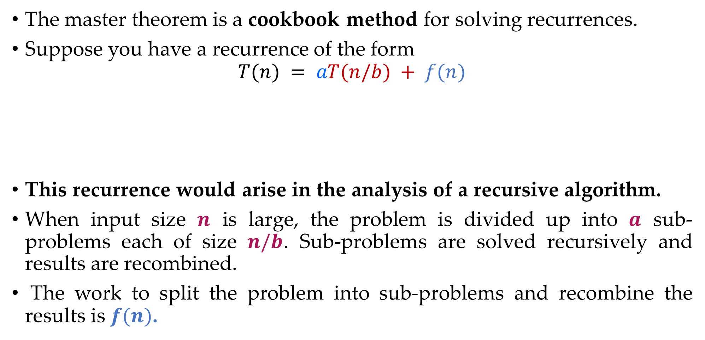
Master Theorem
The master theorem is a cookbook method for solving recurrences.
Suppose you have a recurrence of the form
$$T(n) = aT(n/b) + f(n)$$
This recurrence would arise in the analysis of a recursive algorithm.
When input size $n$ is large, the problem is divided up into $a$ sub-problems each of size $n/b$. Sub-problems are solved recursively and results are recombined.
The work to split the problem into sub-problems and recombine the results is $f(n)$.
Time to divide & recombine
Number of sub-problems
Time required to solve a sub-problem

Slide 33
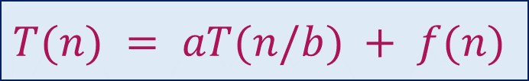
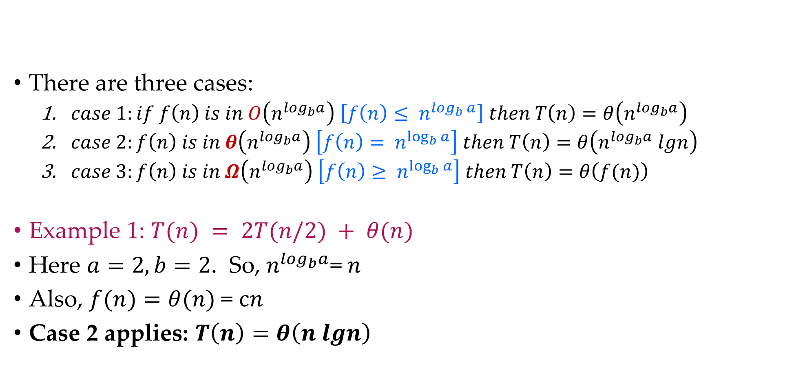
Master Theorem – Example 1
There are three cases:
$case 1:if f\left(n\right) is in O\left(n^{\log_{b}a}\right) \left[f\left(n\right)≤ n^{\log_{b}{a}}\right]$ $then T\left(n\right)=θ\left(n^{\log_{b}a}\right)$
$case 2:f\left(n\right) is in θ\left(n^{\log_{b}a}\right) \left[f\left(n\right)= n^{\log_{b}{a}}\right]$ $then T\left(n\right)=θ\left(n^{\log_{b}a} lgn\right)$
$case 3:f\left(n\right) is in Ω\left(n^{\log_{b}a}\right) \left[f\left(n\right)≥ n^{\log_{b}{a}}\right] then T\left(n\right)=θ\left(f(n)\right)$
Example 1: $T(n) = 2T(n/2) + θ(n)$
Here $a=2, b=2$. So,${ n}^{\log_{b}a}$= $n$
Also, $f(n)=θ(n)$= $cn$
Case 2 applies: $T\left(n\right)=θ\left(n lgn\right)$
$$T(n) = aT(n/b) + f(n)$$
Merge sort

Slide 34
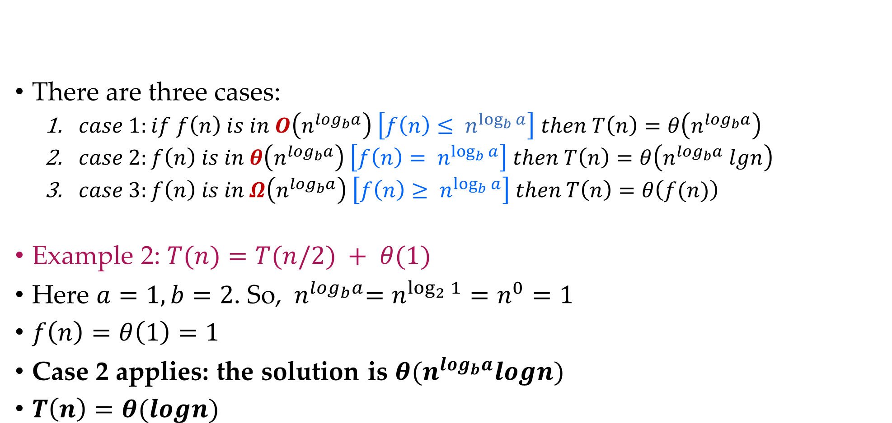
Master Theorem – Example 2
There are three cases:
$case 1:if f\left(n\right) is in O\left(n^{\log_{b}a}\right) \left[f\left(n\right)≤ n^{\log_{b}{a}}\right]$ $then T\left(n\right)=θ\left(n^{\log_{b}a}\right)$
$case 2:f\left(n\right) is in θ\left(n^{\log_{b}a}\right) \left[f\left(n\right)= n^{\log_{b}{a}}\right]$ $then T\left(n\right)=θ\left(n^{\log_{b}a} lgn\right)$
$case 3:f\left(n\right) is in Ω\left(n^{\log_{b}a}\right) \left[f\left(n\right)≥ n^{\log_{b}{a}}\right] then T\left(n\right)=θ\left(f(n)\right)$
Example 2: $T(n)=T(n/2) + θ(1)$
Here $a=1, b=2$. So, ${ n}^{\log_{b}a}=n^{\log_{2}{1}}=n^{0}=1$
$f\left(n\right)=θ\left(1\right)=1$
Case 2 applies: the solution is $θ(n^{\log_{b}a}logn)$
$T\left(n\right)=θ(logn)$
$$T(n) = aT(n/b) + f(n)$$
Binary Search

Slide 35

Master Theorem – Example 3
There are three cases:
$case 1:if f\left(n\right) is in O\left(n^{\log_{b}a}\right) \left[f\left(n\right)≤ n^{\log_{b}{a}}\right]$ $then T\left(n\right)=θ\left(n^{\log_{b}a}\right)$
$case 2:f\left(n\right) is in θ\left(n^{\log_{b}a}\right) \left[f\left(n\right)= n^{\log_{b}{a}}\right]$ $then T\left(n\right)=θ\left(n^{\log_{b}a} lgn\right)$
$case 3:f\left(n\right) is in Ω\left(n^{\log_{b}a}\right) \left[f\left(n\right)≥ n^{\log_{b}{a}}\right] then T\left(n\right)=θ\left(f(n)\right)$
Example 3: $T(n)=4T(n/2) + n$
Here $a=4, b=2$. So, $logba=2$and $n^{\log_{b}a}$ $=n2$
$f\left(n\right)=n,$
So, $f(n)≤n2 ⇒f(n)$is in $O(n^{\log_{b}a})$
Case 1 applies: $T(n)=θ(n2)$
$$T(n) = aT(n/b) + f(n)$$

Slide 36



Recurrence Tree Method
In recurrence tree, each node represents the cost of a single sub-problem in the set of recursive function invocations.
We sum the costs within each level of the tree to obtain a set of per level costs.
Then we sum the all the per level costs to determine the total cost of all levels of the recursion.
Here while solving recurrences, we divide the problem into sub-problems of equal size.
E.g., $T(n)=a T(n/b) + f(n)$where $a>1 ,b>1$and $f(n)$ is a given function.
$F(n)$ is the cost of splitting or combining the sub problems.
$$n$$
$$n/b$$
$$n/b$$

Slide 37













Recurrence Tree Method
Example 1: $T(n)=2T(n/2)+n$
When we add the values across the levels of the recursion tree, we get a value of $n$ for every level.
The bottom level has $2^{\log{n}}$ nodes, each contributing the cost $T(1).$
We have $n + n + n + …… log⁡n$ $times$
$$T(n)= \sum_{i=0}^{\log_{2}{n}−1}{n+2^{\log{n}}T(1)}$$
$T\left(n\right)=n\log{n}+n$
$$T\left(n\right)=O(n\log{n)}$$
The recursion tree for this recurrence is
$$n$$
$$n/2$$
$$n/2$$
$$n$$
$$log2 n$$
$$n/{2^{2}}$$
$$n/{2^{2}}$$
$$n/{2^{2}}$$
$$n/{2^{2}}$$
$$n$$
$$1$$
$$1$$
$$1$$
$$1$$

Slide 38












Recurrence Tree Method
Example 2: $T(n)=T(n/3)+T(2n/3)+n$
When we add the values across the levels of the recursion tree, we get a value of $n$ for every level.
$$T(n)= \sum_{i=0}^{\log_{3/2}{n}−1}{n+n^{\log_{3/2}{2}}T(1)}$$
$$T(n)∈n \log_{3/2}{n}$$
The recursion tree for this recurrence is
$$n$$
$$n/3$$
$${2n}/3$$
$$n$$
$$log3 n$$
$$log3/2 n$$
$$\frac{1}{3}\frac{n}{3}$$
$$\frac{2}{3}\frac{n}{3}$$
$$\frac{1}{3}\frac{2n}{3}$$
$$\frac{2}{3}\frac{2n}{3}$$
$$n$$

Slide 39











Recurrence Tree Method
Example 3: $T(n)=2T(n/2)+c.n2$
Sub-problem size at level$i$is $n/{2^{i}}$
Cost of problem at level $i$Is ${\left(n/{2^{i}}\right)}^{2}$
Total cost,
$$T\left(n\right)≤n^{2}\sum_{i=0}^{\log_{2}{n−1}}{{\left(\frac{1}{2}\right)}^{i}}$$
$$T\left(n\right)≤n^{2}\sum_{i=0}^{∞}{{\left(\frac{1}{2}\right)}^{i}}$$
$$T\left(n\right)≤ {2n}^{2}$$
$$T\left(n\right)=O\left(n^{2}\right)$$
The recursion tree for this recurrence is
$$n^{2}$$
$${\left(n/2\right)}^{2}$$
$${\left(n/2\right)}^{2}$$
$${1/2n}^{2}$$
$${\left(n/4\right)}^{2}$$
$${\left(n/4\right)}^{2}$$
$${\left(n/4\right)}^{2}$$
$${\left(n/4\right)}^{2}$$
$${1/4n}^{2}$$
$$O\left(n^{2}\right)$$

